Slide 1
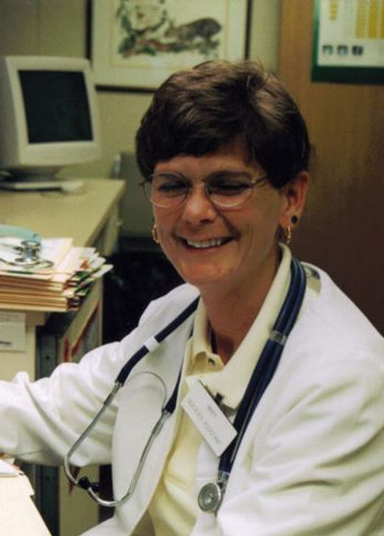
Mary Moody Award Recipients
NCSMA

Slide 2
Darnell Hudson, CMA(AAMA) 2000 Burke Chapter
Becky Keller, CMA(AAMA)
2001
Catawba Chapter

Slide 3
Carla Gordan, CMA(AAMA) 2002 Union County Chapter (Picture not available)
Emma Bolch, CMA(AAMA)
2003
Catawba Chapter

Slide 4
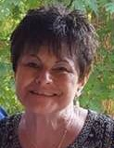
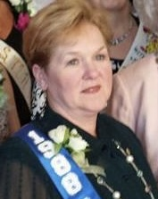
Ann Stroup, CMA(AAMA) 2004
Kathy Green, CMA (AAMA)
2005
High Point
Nina Watson, CMA(AAMA) CPC
2006
Cumberland Chapter

Slide 5
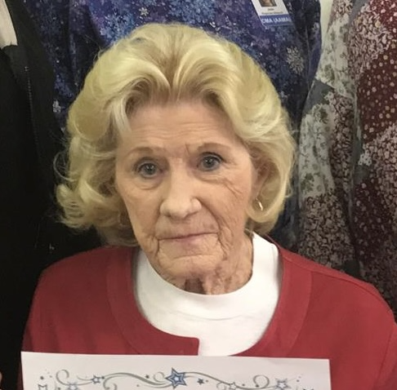
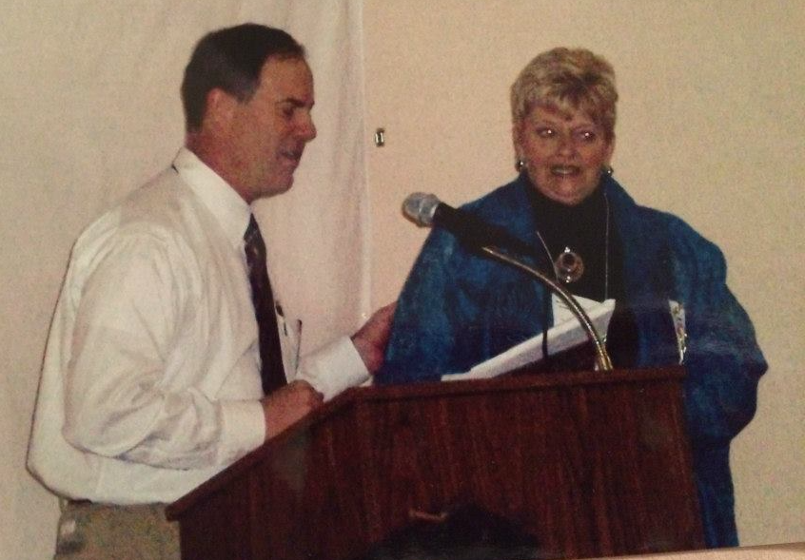
2007 No Award Given
Gail Greene, CMA(AAMA)
2008
Haywood Chapter
Betty Jones, Associate
2009
Haywood Chapter

Slide 6
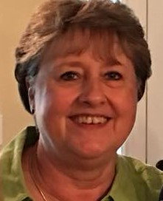
Phyllis Wade, CMA (AAMA)
2010
FSD Chapter
Paula Cooke, CMA(AAMA)
2011
Surry Chapter
Elaine Norman, CMA(AAMA)
2012
Catawba Chapter

Slide 7
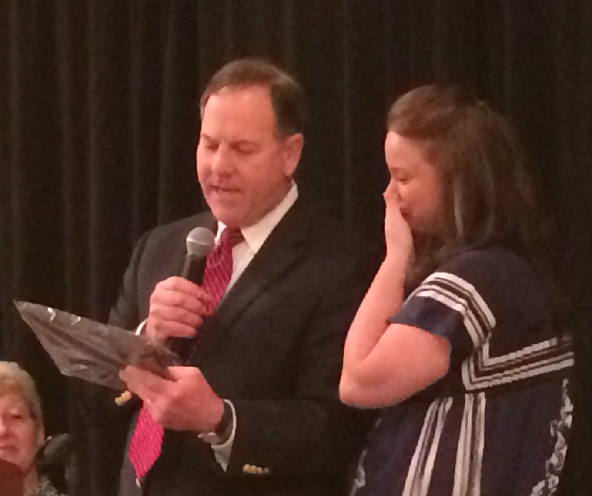
Jean Migliarini, CMA(AAMA) 2013 Haywood Chapter
Deborah Brown, CMA(AAMA)
2014
Albemarle Chapter
(pictured not shown)
Rebecca Surratt, CMA(AAMA)
2015
Surry Chapter

Slide 8
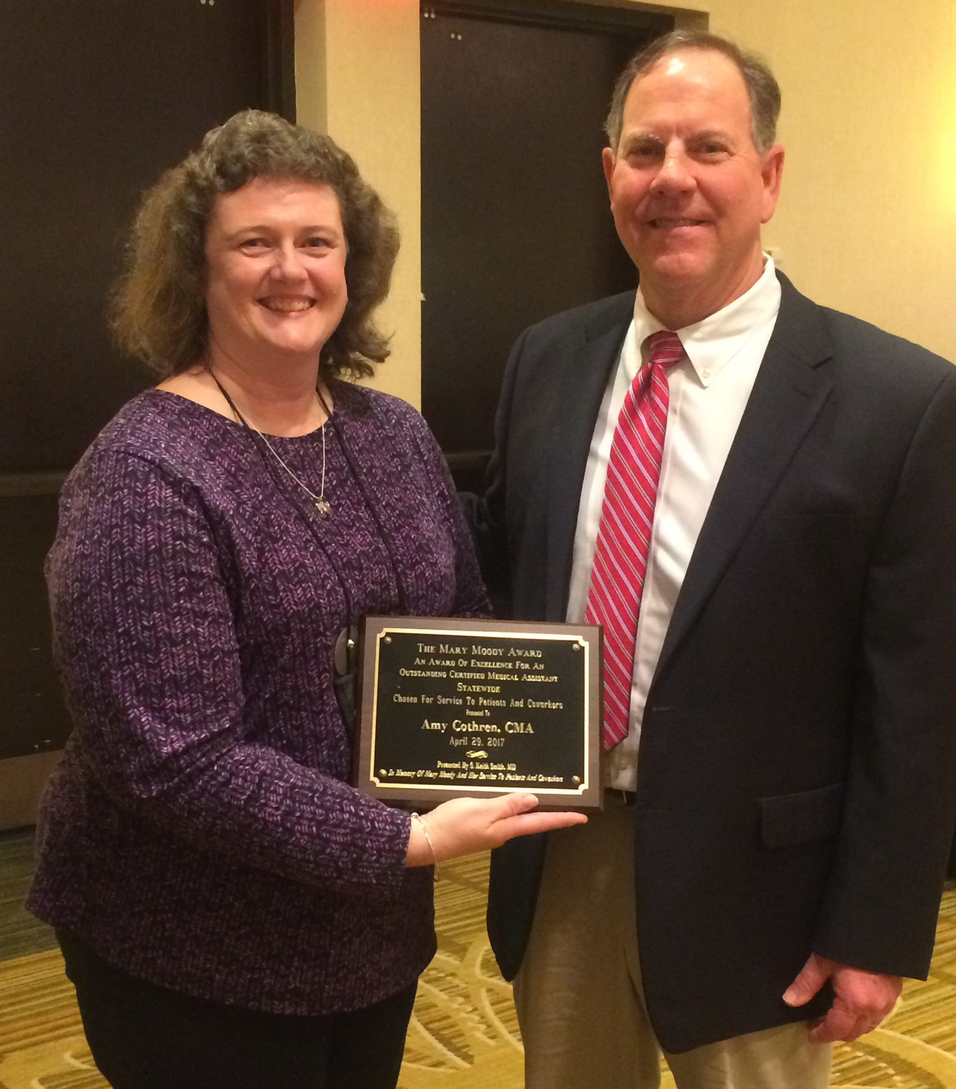
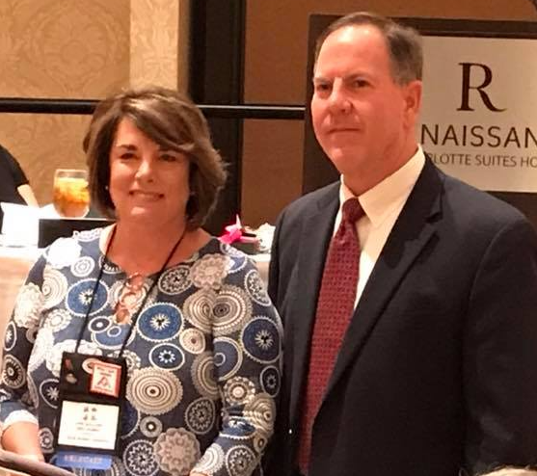
Vicki Shuping, CMA(AAMA) 2016 Burke Chapter
Amy Cothren, CMA(AAMA)
2017
Surry Chapter
Lynn Williams, CMA(AAMA)
2018
Greensboro Chapter

Slide 9
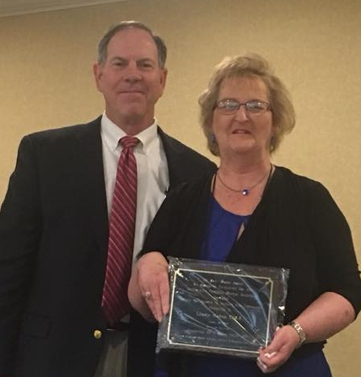
Linda Eaton, CMA(AAMA) 2019 Surry Chapter
2020 No Award Given
2021 No Award Given

Slide 10
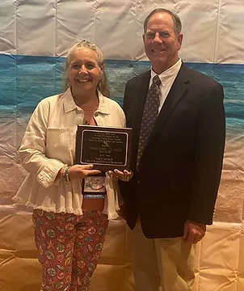
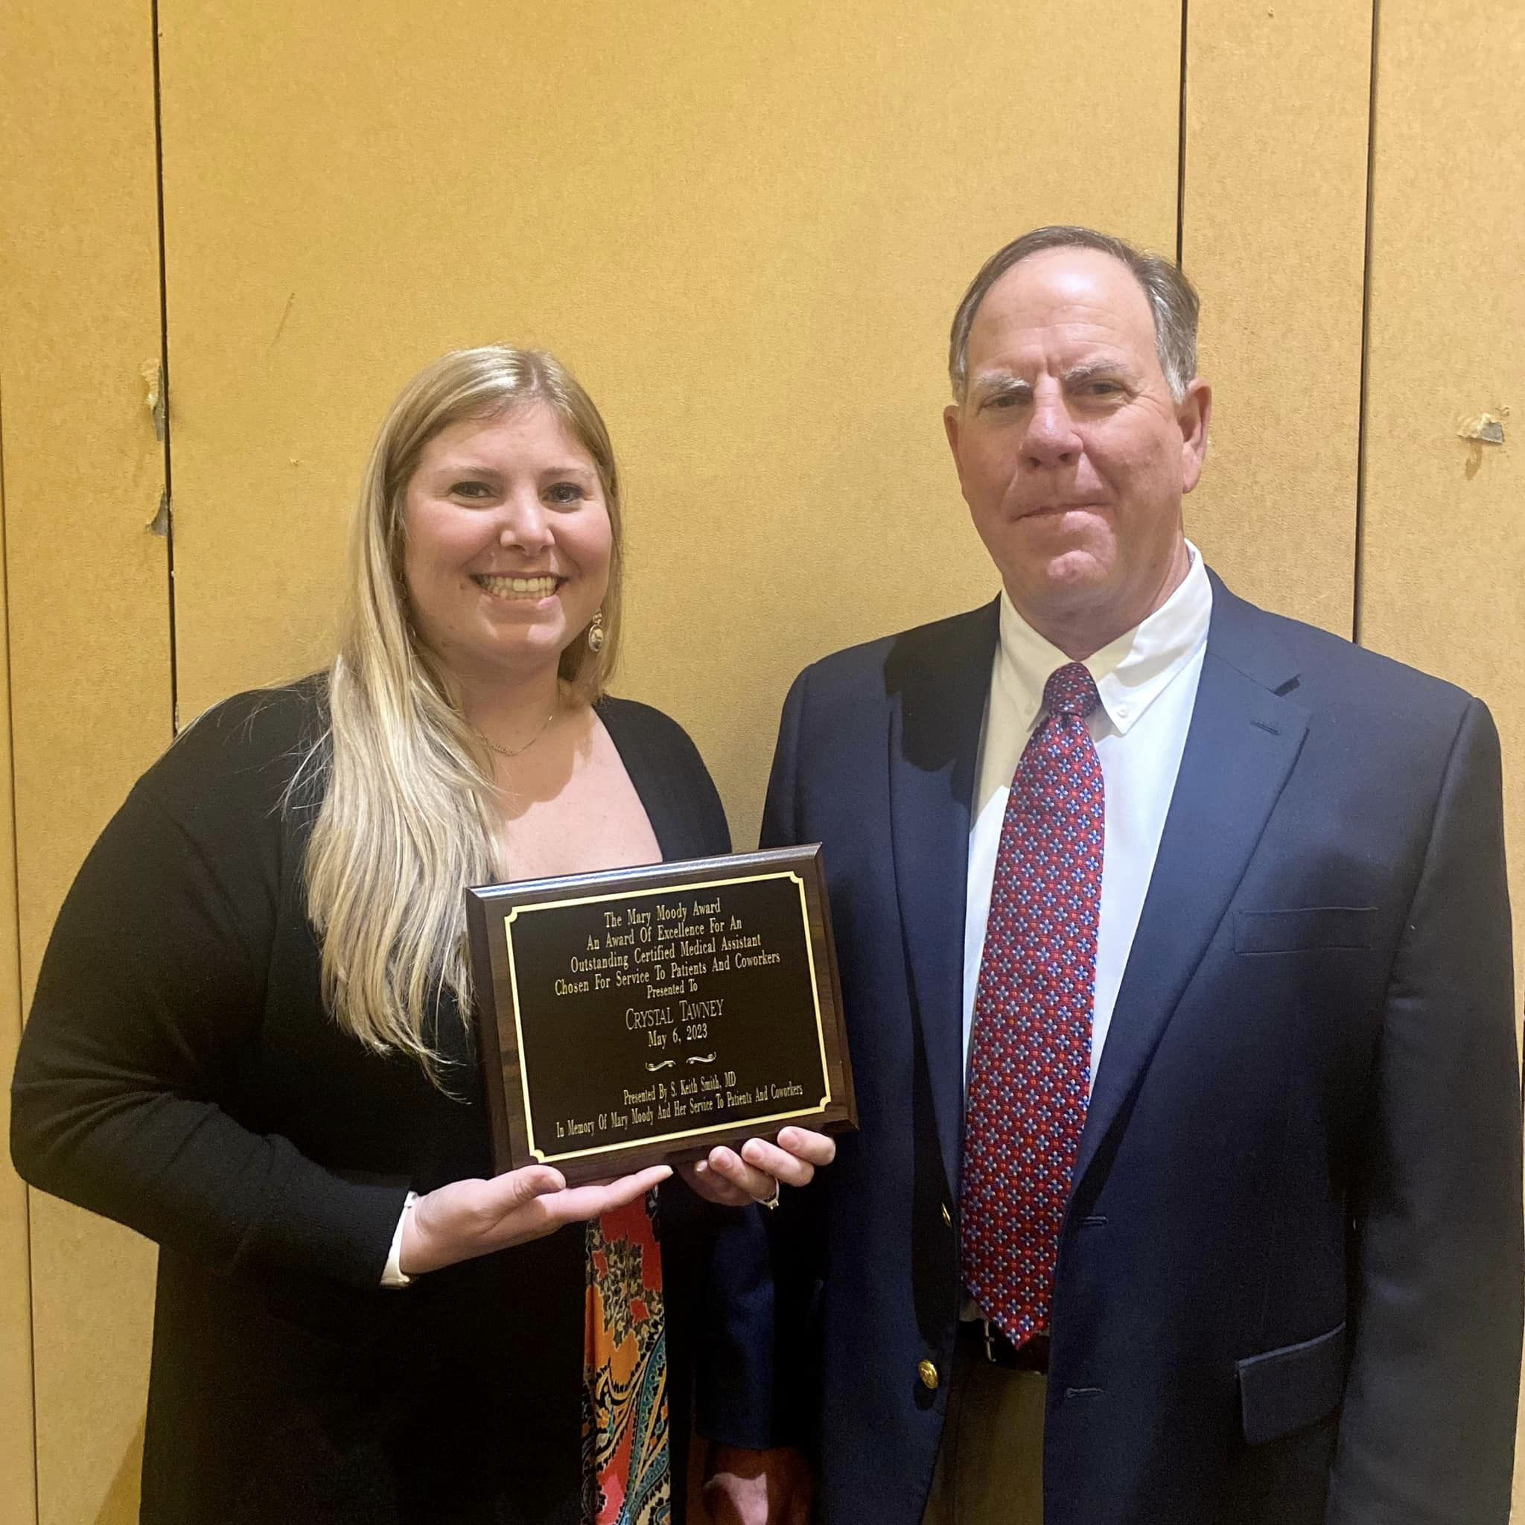
Debby McBride, CMA(AAMA) 2022
Union Chapter
Crystal Tawney
CMA(AAMA)
2023
Greensboro Chapter

